Slide 1
AMAZON.COM, INC.
Discounted Cash Flow Valuation
FY2024 Revenue
Operating Income
Net Income
Price Target
$638.0B
$68.6B
$59.2B
$170
+10.9% YoY
+86% YoY
+95% YoY
DCF Estimate
Source: Amazon.com 10-K FY2024 (SEC Filing) | WACC: 9.2% | Terminal Growth: 3.5%
North America $387.5B
AWS $107.6B
International $142.9B
TICKER: AMZN | NASDAQ | Fiscal Year Ending December 31, 2024

Slide 2
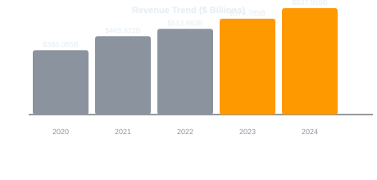
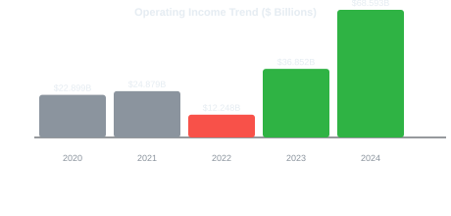
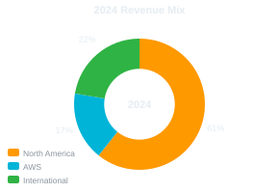
COMPANY OVERVIEW & SEGMENT ANALYSIS
FY2024 10-K Data
North America
AWS
International
Revenue
Revenue
Revenue
$387.5B
$107.6B
$142.9B
Operating Income
Op. Margin
Operating Income
Op. Margin
Operating Income
Op. Margin
$25.0B
6.5%
$39.8B
37.0%
$3.8B
2.6%
Source: Amazon.com, Inc. Form 10-K (FY2024) filed February 6, 2025 with the SEC

Slide 3
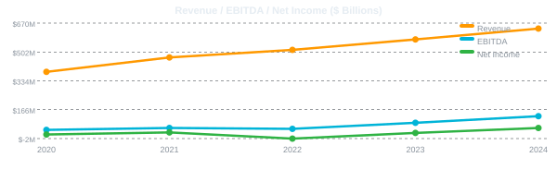
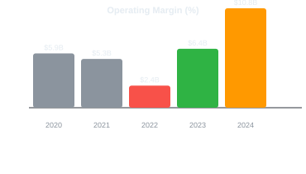
HISTORICAL INCOME STATEMENT SUMMARY ($ millions)
Metric | 2020 | 2021 | 2022 | 2023 | 2024
Net Sales | $386,065 | $469,822 | $513,983 | $574,785 | $637,959
Gross Profit | $152,758 | $197,478 | $225,152 | $270,046 | $311,671
Gross Margin | 39.6% | 42.0% | 43.8% | 47.0% | 48.8%
Operating Income | $22,899 | $24,879 | $12,248 | $36,852 | $68,593
Operating Margin | 5.9% | 5.3% | 2.4% | 6.4% | 10.8%
EBITDA | $48,150 | $59,312 | $54,169 | $89,439 | $127,971
EBITDA Margin | 12.5% | 12.6% | 10.5% | 15.6% | 20.1%
Net Income | $21,331 | $33,364 | $(2,722) | $30,425 | $59,248
D&A | $25,251 | $34,433 | $41,921 | $52,587 | $59,378
Capex | $40,140 | $61,053 | $63,645 | $52,729 | $77,366
Operating Cash Flow | $66,064 | $46,327 | $46,752 | $84,946 | $115,879
All figures sourced directly from Amazon.com, Inc. Form 10-K filings with the SEC (FY2020–FY2024). FY2022 net loss driven by Rivian equity markdowns.

Slide 4
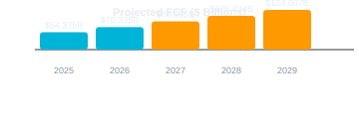
DCF MODEL — ASSUMPTIONS & PROJECTED FREE CASH FLOWS ($ millions)
DCF ASSUMPTIONS
Metric | 2025 | 2026 | 2027 | 2028 | 2029
Revenue | $715B | $793B | $872B | $960B | $1046B
EBITDA | $154B | $178B | $205B | $230B | $256B
EBITDA Margin | 21.5% | 22.5% | 23.5% | 24.0% | 24.5%
Less: D&A | -$63B | -$68B | -$72B | -$78B | -$83B
EBIT | $91B | $110B | $133B | $153B | $174B
Less: Taxes (20%) | -$18B | -$22B | -$27B | -$31B | -$35B
NOPAT | $73B | $88B | $106B | $122B | $139B
Add: D&A | +$63B | +$68B | +$72B | +$78B | +$83B
Less: Capex | -$79B | -$83B | -$87B | -$91B | -$94B
Less: ΔNWC | $-2.5B | $-2.8B | $-3.0B | $-3.2B | $-3.4B
Free Cash Flow | $54B | $70B | $88B | $105B | $124B
Discount Factor | 0.916 | 0.839 | 0.768 | 0.703 | 0.644
PV of FCF | $50B | $59B | $68B | $74B | $80B
WACC
9.2%
Terminal Growth Rate
3.5%
Projection Horizon
5 Years (2025–2029)
Tax Rate
20.0%
Revenue Growth
2025E
12.0%
2026E
11.0%
2027E
10.0%
2028E
10.0%
2029E
9.0%
EBITDA Margin
2025E
21.5%
2026E
22.5%
2027E
23.5%
2028E
24.0%
2029E
24.5%
Capex / Revenue
9.0–11.0%
D&A / Revenue
7.9–8.8%
PV of FCFs
PV Terminal Value
Enterprise Value
Equity Value
Shares (M)
Price Target
$331B
$1450B
$1781B
$1801B
10571
$170

Slide 5
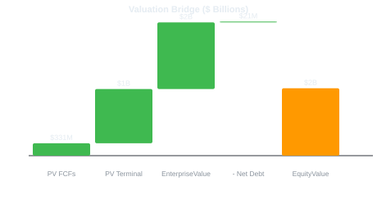
DCF VALUATION BRIDGE & SENSITIVITY ANALYSIS
SENSITIVITY: Share Price vs. WACC × Terminal Growth Rate
WACC \ TGR | 2.5% | 3.0% | 3.5% | 4.0%
8.0% | $183 | $199 | $218 | $242
8.5% | $167 | $180 | $195 | $214
9.0% | $154 | $164 | $177 | $192
9.2% | $149 | $159 | $170 | $184
9.5% | $142 | $151 | $161 | $174
10.0% | $132 | $140 | $148 | $159
10.5% | $123 | $130 | $137 | $146
VALUATION SUMMARY
Total PV of FCFs (2025–2029)
PV of Terminal Value
Enterprise Value
Less: Net Debt
Equity Value
DCF Price Target
$330.6B
$1450.1B
$1780.7B
$-20.7B
$1801.3B
$170
Terminal Value = 81% of Enterprise Value | FCF CAGR (2024–2029): 22.9%
COMPARABLE MULTIPLES CHECK (FY2024)
EV/EBITDA
EV/Revenue
P/E (NTM)
P/FCF
AWS EV
~17x
~3.3x
~35x
~45x
~$700B+
Peers: 15–22x
Peers: 2.5–4.0x
Peers: 30–45x
Growth premium
~25× EBITDA

Slide 6
INVESTMENT THESIS & KEY RISKS
🟢 BULL CASE — Key Growth Drivers
🔴 BEAR CASE — Key Risks
AWS Hyper-Growth
Regulatory Risk
AI/ML workloads accelerating cloud adoption; AWS growing 19% YoY with 37% operating margin. GenAI services expanding TAM.
Antitrust scrutiny in US, EU, and India. FTC lawsuit over marketplace practices. Potential forced restructuring of AWS/marketplace.
Advertising Monetization
Capex Intensity
Ad revenue ~$56B in 2024, growing 18% YoY. High-margin stream with significant scaling potential.
FY2024 capex surged to $77.4B (+47% YoY) for AI infrastructure. Execution risk on ROI timelines for data center buildout.
Margin Expansion
AWS Competition
Operating margin climbed from 2.4% (2022) to 10.8% (2024). Automation and logistics optimization drive further upside.
Microsoft Azure (28% market share) and Google Cloud growing faster in AI workloads. Margin pressure possible.
International Opportunity
Consumer Slowdown
International segment turned profitable in 2024 ($3.8B OI). India, LatAm, and emerging markets represent long runway.
Retail segment (~60% of revenue) sensitive to economic cycles. Discretionary spend compression in recession scenarios.
Prime & Flywheel
Valuation Premium
175M+ Prime members globally. Subscription + 3P seller + logistics creates compounding network effects.
Stock pricing in optimistic long-term scenario. Meaningful de-rating risk if growth disappoints or rates stay elevated.
KEY PERFORMANCE INDICATORS | FY2024 vs. FY2023
Revenue
Gross Margin
Op. Margin
Free Cash Flow
AWS Growth
Ad Revenue
$638.0B
48.8%
10.8%
$38.5B
19.0%
$56.2B
vs $574.8B +10.9%
vs 47.0% +180bps
vs 6.4% +440bps
vs $32.2B +19.6%
vs 13.2% +580bps
vs $46.9B +19.8%
DISCLAIMER: This DCF analysis is for informational purposes only and does not constitute investment advice. All financial data sourced from Amazon.com, Inc. Form 10-K filed February 6, 2025 with the SEC. Projections involve significant uncertainty.

